Slide 1
Speed control of dc motor using Arduino(pwm method)
Karan pawar 23bee0038
Ayush Bharadwaj 23bee0118
Md Furqaan Ansari 23bee0081

Slide 2
Aim:- To design and implement a simple system to control the speed of a dc motor using pwm signals from an arduino.
OBJECTIVE:-
To design and implement a DC motor control system using Arduino Uno and L293D motor driver.
2. To control the speed of a DC motor through an analog input (potentiometer).
3. To control the direction of rotation (forward and reverse) of the DC motor.
4. To interface a motor driver (L293D) with Arduino for bidirectional motor control.
5. To develop a simple user-controlled setup for variable speed and direction control.
6. To understand PWM (Pulse Width Modulation) technique for motor speed variation.
7. To observe and analyze the effect of PWM duty cycle on the motor speed.

Slide 3
Introduction
This project aims to control the speed and direction of a DC motor using an Arduino Uno, L293D motor driver, and a potentiometer.The potentiometer provides an analog input to Arduino, which generates a PWM signal to vary the motor speed.The L293D driver allows the motor to rotate forward or reverse based on the control signals from Arduino.

Slide 4
Literature review
1)DC Motor Control Basics:
Early works establish voltage and armature-current control for speed regulation in brushed DC motors; PWM emerged as an efficient method to vary average voltage without large losses.
2)PWM for Speed Control:PWM duty cycle linearly relates to average motor voltage; studies show improved efficiency and thermal performance vs. linear regulation.
3)H-Bridge Drivers (L293D/L298):Classic bipolar H-bridge ICs enable bidirectional control with current limiting; widely used in low–medium power educational and prototyping setups.
4)Microcontroller-Based Control (Arduino):Literature highlights Arduino as a low-cost, rapid-prototyping platform for motor control—simple ADC-to-PWM pipelines for analog inputs (e.g., potentiometer).
5)Direction + Speed via Two-Input Logic:Common approach uses two direction pins + one PWM enable; dead-zone handling around mid-ADC improves stability and prevents chatter.

Slide 5
6)Control Enhancements:PID/closed-loop control with encoders improves speed regulation under load; current sensing adds protection and better torque control.
7)Applications & Trends:Robotics and EV subsystems use PWM H-bridges extensively; movement toward higher-efficiency drivers and integrated current/thermal protection

Slide 6

Block diagram

Slide 7
Hardware parts
Arduino UNO: Reads analog voltage and generates PWM signals.
L293D Motor Driver: Provides bidirectional control to the motor. •
Potentiometer: Acts as a user input to vary the voltage from 0–5V. •
DC Motor: The load whose speed is being controlled. •
Power Supply: Provides power to Arduino and motor driver.

Slide 8
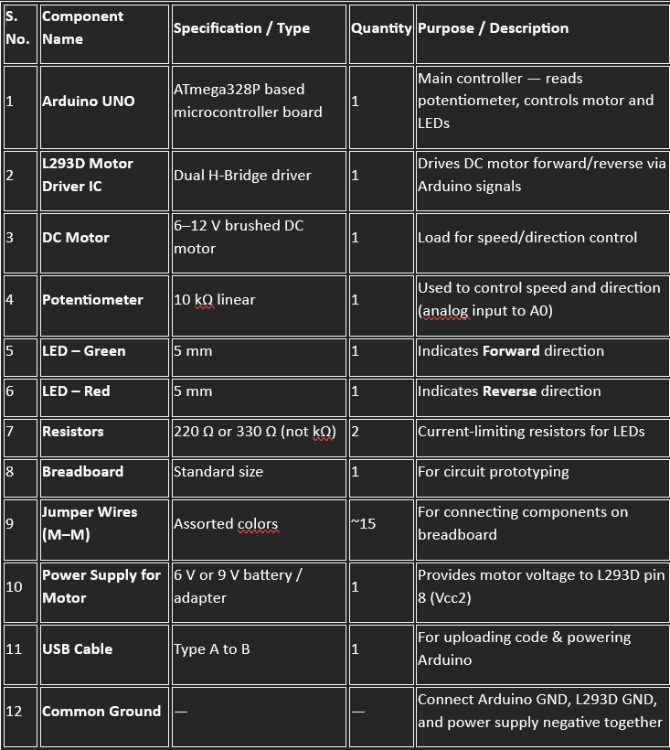

Slide 9
Working principle
1)The potentiometer provides an analog input (0–1023) to the Arduino Uno based on its rotation.
2)Arduino reads this value and generates a corresponding PWM (Pulse Width Modulated) signal on the enable pin of the L293D motor driver.
3)The PWM duty cycle controls the average voltage applied to the DC motor, thus varying its speed.
4)The L293D also controls the direction of rotation — by changing the logic levels on input pins (IN3 and IN4), the current flow through the motor is reversed, allowing forward or reverse motion.
5)When the potentiometer is in the middle position, both inputs are set LOW, stopping the motor

Slide 10
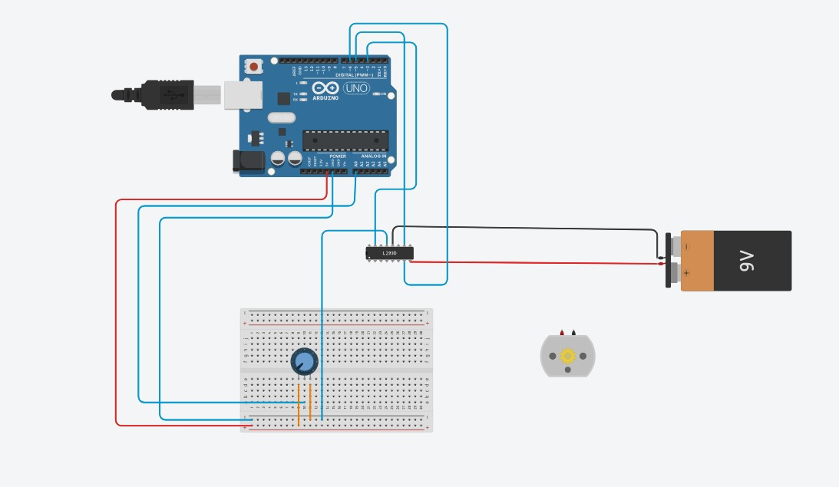
Circuit diagram

Slide 11
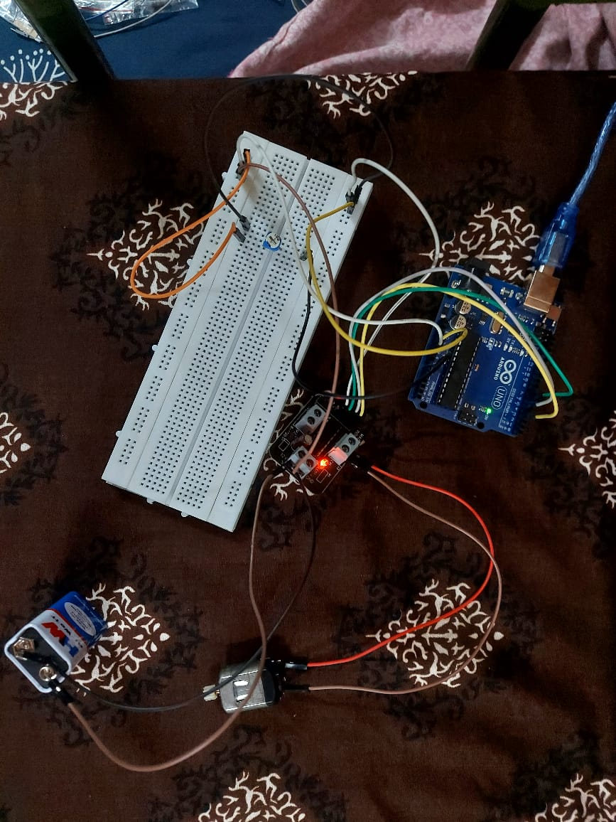
Circuit diagram

Slide 12
Circuit connections
1)Potentiometer:
One terminal → 5V (Arduino)
Second terminal → GND Middle
(wiper) terminal → A0 (Analog input)
2)L293D Motor Driver:
IN3 → D5 (Arduino digital pin)
IN4 → D3 (Arduino digital pin)
EN2 → D6 (PWM pin for speed control)
Vcc1 (Pin 16) → 5V (Logic supply)
Vcc2 (Pin 8) → External motor supply (6–12V as per motor rating)
GND (Pins 4, 5, 12, 13) → Common Ground (Arduino + Motor supply)
OUT3 & OUT4 → DC Motor terminals
3)Common Ground:
Connect the Arduino GND and Motor Power GND together.

Slide 13
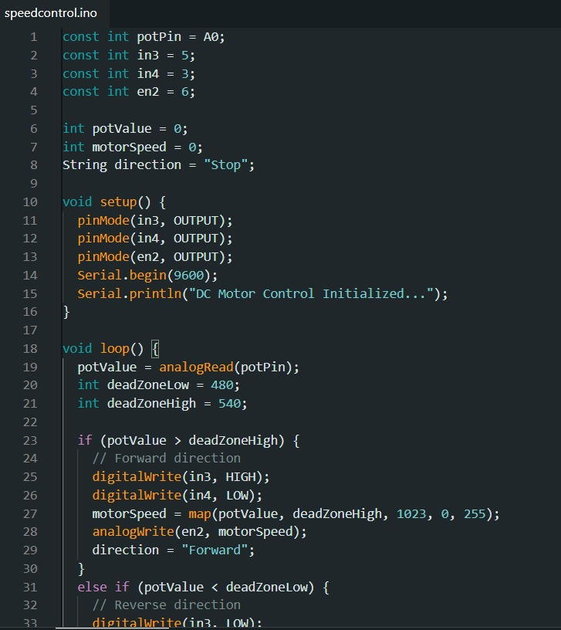
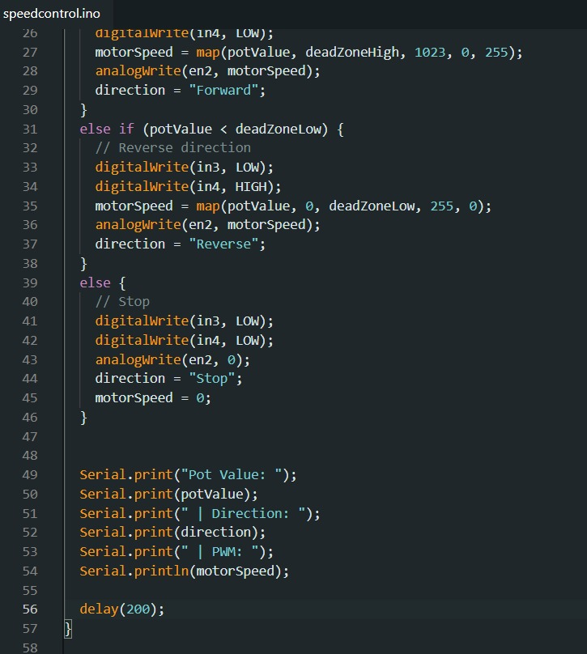
Arduino code

Slide 14
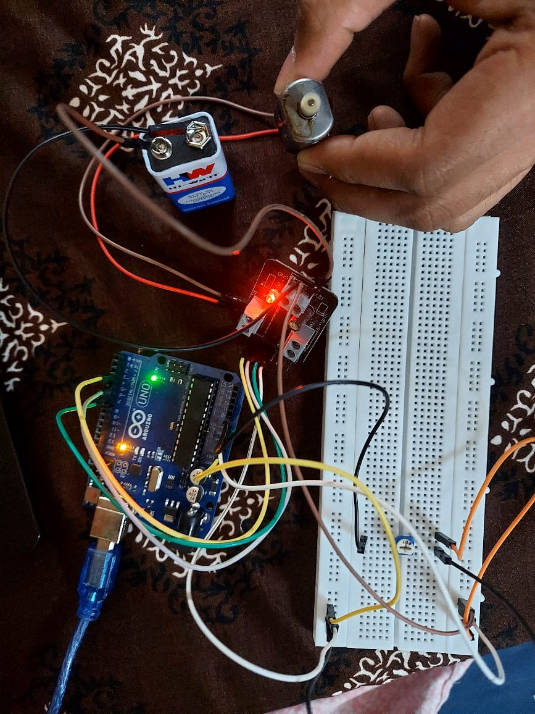
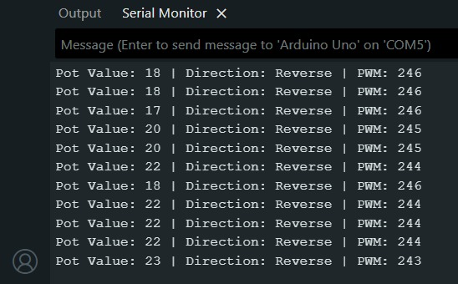
results
The motor speed changed linearly with potentiometer rotation. When the potentiometer knob was in the mid-position, the motor stopped. Turning clockwise increased speed in the forward direction, while counter-clockwise rotation caused reverse motion. PWM output from Arduino ensured smooth speed variation without jerks. The overall setup consumed less power and operated reliably.

Slide 15
1)”DC motor control using arduino”, circuit digest, June 7, 2015 by Dinesh Raja. WEBSITE 2) Mrs. A.Gamyaveni, ”controlling the DC motor speed with PWM using arduino” 2024 IJCRT, volume 12, issue 3 march 2024. PDF 3) Rukmini, M. Rathi and M. S. Aspalli, "Speed Control of DC Motor using PWM Technique," 2024 5th IEEE Global Conference for Advancement in Technology (GCAT), Bangalore, India, 2024, pp. 1-6, doi: 10.1109/GCAT62922.2024.10923985. WEBSITE 4) Tesfaye, H.K. And liu, J. (2025) “Speed and direction control of DC motor using arduino uno microcontroller” Scientific Research, Vol.12 no.3, March 2025 DOI: 10.4236/oalib.1113007. PDF.
REFERENCE

